Slide 1
Drowsiness Detection
Group-43 1.D.Nikhil-S20170010045
2. Raja Aluri-S20170010119
3. Sahil-S20170010133
4. Kale Prem Kumar-S20170020212

Slide 2
Introduction
Each year hundreds of people lose their lives due to traffic accidents around the world. Unfortunately, Iran ranks first in the world in terms of road fatalities and each year approximately thirty thousands of fellow countrymen lose their lives in these events .
In a study by the National Transportation Research Institute (NTSRB) in which 107 random car accidents had been selected, fatigue accounted for 58% of the all accidents. A main cause of fatigue is sleeplessness or insomnia.
Ad hoc networks were the first systems to develop the automatic navigation in cars . A noticeable weakness of these systems is that their responses to environmental changes is not real time.
It is especially important in driving where time is a critical factor in driver's decision. On the other hand, another method to check the driver fatigue is monitoring the physical condition and facial expressions of the drivers.

Slide 3
Problem Definition
The system deals with using information obtained for the binary version of the image to find the edges of the face, which narrows the area of where the eyes may exist
The system is also able to detect when the eyes cannot be found, and works under reasonable lighting conditions.
The system also works for the yawning and generates warning if a person is found yawning.
The system also generates warning when the head is lowered or is turned to different sides, for more than threshold consecutive seconds

Slide 4
CAMERA
DIVIDING INTO FRAMES
FACE DETECTION
MOUTH DETECTION
EYE DETECTION
HEAD LOWERING
DROWSINESS DETECTION
ALARM

Slide 5
Steps Involved
First,we take a camera input
Then,divide the video into the frames
Then ,we will detect faces in the given image(frame)
Later,we detect the eyes and mouth region in the face image(ROI)
Detect the state of eye.If the eye is closed for some certain amount of consecutive time .we classify the person as drowsy.
Yawn detection:If a person yawns we decide that the person is drowsy
Head lowering:If person slowly lowers this head ,we can say that he is drowsy

Slide 6
Drowsiness detection approach
Two Approaches
Deciding the state of eye by calculating the difference between the amout of white pixels present in the eye region.For deciding the state of mouth,we calculate the amount of red component present in mouth region.
Second approach is achieved by using facial landmarking.By calcutating the aspect ratio of mouth and eyes.Then use this aspect ratio to decide the state of eyes and mouth(open/close)

Slide 7
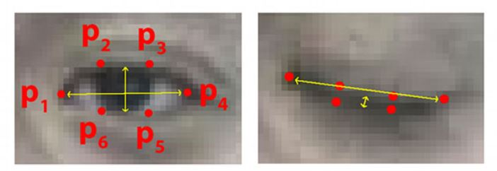
Deciding the state of eye using eye aspect ratio
Using the vertical and horizontal eye landmarks .we calculate the horizontal distance & the average of vertical distance.
Then ,we calculate the ratio of vertical distance to that of the horizontal.This value is the eye aspect ratio.
Then we set threshold,If the ear below the threshold we determine that the eye is closed

Slide 8
MOUTH DETECTION
In this method we will use euclidean distance algorithm to find the distance between points.
We will find distance between two points on horizontal axis and we will repeat this for all the points present on horizontal axis.
Then we will calculate its average in horizontal axis for distances.(say M)
In the same way we will find distance between two points on vertical axis.Then we will average it.
Then we repeat for all points present on different vertical axes.

Slide 9
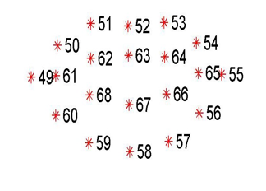
Now we will calculate average distance for all vertical axis(N).
Then we will calculate the ratio of vertical distance to horizontal distance.
RATIO = VERTICAL DISTANCE(N) / HORIZONTAL DISTANCE(M)
If RATIO >1 the mouth is open and it will detect drowsiness.
If RATIO <1 the mouth is closed.

Slide 10
Skin Segmentation
An image which taken inside a vehicle includes the driver’s face. Typically a camera takes images within the RGB model (Red, Green and Blue). However, the RGB model includes brightness in addition to the colours. When it comes to human’s eyes, different brightness for the same color means different colour.
When analyzing a human face, RGB model is very sensitive in image brightness. Therefore, to remove the brightness from the images is second step. We use the YCbCr space since it is widely used in video compression standards .
Since the skin-tone color depends on luminance, we nonlinearly transform the YCbCr colour space to make the skin cluster luma-independent. This also enables robust detection of dark and light skin tone colours. The main advantage of converting the image to the YCbCr domain is that influence of luminosity can be removed during our image processing.
In the RGB domain, each component of the picture (red, green and blue) has a different brightness. However, in the YCbCr domain all information about the brightness is given by the Y component, since the Cb (blue) and Cr (red) components are independent from the luminosity.

Slide 11
Skin segmentation
Conversion from RGB to YCbCr
Cb = (0.148* Red) - (0.291* Green) + (0.439 * Blue) + 128;
Cr = (0.439 * Red) - (0.368 * Green) – (0.071 * Blue) + 128;
Conversion from RGB to HSV
MATLAB has predefined function for conversion of RGB color space to HSV color space.
I’ = rgb2hsv (I);

Slide 12
Decision Making
The first frame is used for learning. All the results are calculated taking first frame as ideal frame.
Eyes Closed
When eyes are closed, the number of black pixels in binary image decreases considerably. If eyes are found closed for atleast 2 consecutive seconds (i.e. 2 * 16 = 32 frames, considering 16 frames per second), then the warning will be generated.
Mouth Open
When mouth is open, the resulting black pixels in binary image can be considerably larger or smaller than the ideal frame. The difference can be more than 6% of the black pixels in ideal frame.If mouth is found open for atleast 2 consecutive seconds (i.e. 2 * 16 = 32 frames, considering 16 frames per second), it means that the person is yawning and in response the warning will be generated.

Slide 13
Decision Making
Head Lowering
If the head is lowered, or turned around the number of skin pixels considerably decrease as compared to the ideal frame.If head is found lowered or found turned in other directions for atleast 2 consecutive seconds (i.e. 2 * 16 = 32 frames, considering 16 frames per second), it means that the person is vulnerable for accident and in response the warning will be generated.

Slide 14
Limitations of the algorithm
Objects in the video, should be uniformly illuminated, else results can differ.
Changing distance of person from the camera can cause problems.
Head lowering can give abrupt results in case of bald person.
The algorithm doesn’t work for the people sleeping with eyes open.
Face symmetry calculations are not same for everyone. The calculations considered are true for most of the people.

Slide 15
References
[1] G. Hosseini, H. Hossein-Zadeh, A "Display driver drowsiness Warning system", International Conference of the road and traffic accidents, Tehran University, 2006.
[2] L. M Bergasa, J. u. Nuevo, M A. Sotelo, R Barea and E. Lopez, "Visual Monitoring of Driver Inattention," Studies in Computational Intelligence (SCI), 2008.
[3] Viola, Jones: Robust Real-time Object Detection, IJCV 2001 pages 1,3.
[4] C. Zhang, X Lin, R Lu, P.H. Ho, X Shen, "An efficient message authentication scheme for vehicular communications". IEEE Trans Veh TechnoI57(6):3357-3368.2008.
[5] S. S. Manv M.S. Kakkasager J. Pitt, "MuItiagent based infonnation dissemination in vehicular ad hoc networks". Mobile Infonn Syst 5(4 ):363-389.2009.
[6] http://en.wikipedia.org/wiki/Haar-like_features

